Slide 1
ALTİD
Brand Identity Presentation
Alanya Turistik Otelciler Derneği · June 2026

Slide 2
Contents
01
Vision & Mission
04
Typography
02
Color System
05
Website Design
03
Logo Design

Slide 3
01 Vision & Mission
The purpose and direction of ALTİD

Slide 4
Vision Statement
“
To be the leading voice of hospitality excellence in the Eastern Mediterranean — elevating Alanya as a world-class destination through sustainable tourism, cultural heritage, and the spirit of Turkish hospitality.
Where Alanya Speaks to the World

Slide 5
Mission Statement
ALTİD unites Alanya's tourism professionals to champion quality standards, advocate for sector interests, and connect members with global markets — fostering collaboration between hoteliers, government, and international tourism bodies.
A
C
E
S
Advocacy
Collaboration
Excellence
Sustainability
Representing member interests with government & global bodies
Bridging hoteliers, agencies & destination stakeholders
Promoting quality standards & best hospitality practices
Supporting eco-responsible tourism for future generations

Slide 6
02 Color System
A palette grounded in Alanya's landscape, history, and culture

Slide 7
The ALTİD Color Palette
NEUTRAL LIGHT
NEUTRAL DARK
ACCENT
SUPPORTING
Deep Charcoal
SECONDARY 1
SECONDARY 2
Taurus Olive
Aegean Sand
PRIMARY
Alanya Terracotta
Saffron Gold
Mediterranean Navy
Mediterranean Turquoise
#2A2A2A
#5A7A3A
#F5EDD8
#E8920A
–
Black
#1A9BC8
#C4421A
PMS 364 C
#1B2E5E
PMS 7526 C
PMS 1375 C
PMS 281 C
PMS 7459 C

Slide 8
Color Rationale — Each Color Tells a Story
Navy
The deep Mediterranean at dusk and Alanya's evening sky. Anchors trust, professionalism, and institutional credibility — echoing İznik tile tradition.
Turquoise
The crystal-clear coastal waters that define the Turkish Riviera. Communicates sea, warmth, and vacation to any audience worldwide.
Terracotta
Literal color of Alanya Castle walls and the Kızılkule (Red Tower, 1226 CE). Evokes sun-baked Anatolian clay and the historical dimension of the brand.
Gold
Alanya's 300+ sunny days and the richness of Turkish cuisine — saffron, baklava, honey. Replaces the old muted amber with a confident, digitally-optimized value.
Olive
The Taurus Mountains rising behind the city. Brings the land narrative missing from the original logo, plus gastronomical significance: world-class olive oil region.

Slide 9
Color Usage Guidelines
Hierarchy of Use
Combinations to Avoid
✕ Terracotta text on Saffron Gold backgrounds
60–70% Mediterranean Navy
✕ Navy text on Turquoise (insufficient contrast)
15–20% Turquoise + secondary palette
✕ Olive as small body text on light backgrounds
5–10% Saffron Gold (CTAs & accents)
✕ More than 3 brand colors in a single panel
~5% Supporting / contextual colors
✕ Saffron Gold as a large-area background fill
WCAG 2.1 — Charcoal on Sand: 9.5:1 ✓ · Navy on Sand: 8.2:1 ✓ · Gold: large text only (moderate contrast ratio)

Slide 10
03 Logo Design
From legacy identity to modern emblem

Slide 11
The ALTİD Logo — Woodcut Emblem
Amber Sun
300+ sunny days · digital-first warm amber (#D07208)
Red Tower
Kizilkule (1226 CE) · 3-face flat shading from sun
Nature Band
Taurus vegetation · quadratic Bezier wave crest
Sand Band
Kleopatra Beach · warm golden coastal strip
Sea Band
Mediterranean · 32px equidistant right-edge bands

Slide 12
Design Philosophy & Continuity
Continuity with Legacy
Graphic Design Best Practices
→ Red Tower (Kızılkule) remains the central icon — instantly recognizable continuity
✓ Woodcut/linocut aesthetic — timeless craft quality, human warmth over corporate gloss
→ Mediterranean turquoise retained as secondary brand color
✓ Flat fills only — no gradients; faithful reproduction in print, embroidery, engraving
→ Horizontal band structure (sky/land/sea) preserved as compositional language
✓ Diagonal composition — upper-left to lower-right flow creates visual tension and energy
→ Amber/gold sun maintained — refined from muted original to digitally-optimized value
✓ Equidistant band spacing at right edge — creates rhythm and reduces visual noise at small sizes

Slide 13
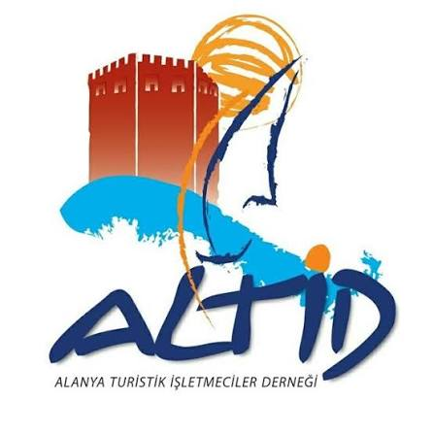
Legacy Logo vs. New Identity
CURRENT LOGO
NEW LOGO — v10
Evolution
Established identity — recognized
by current stakeholders & members
Modernized emblem — built
on the same visual DNA

Slide 14
Maintaining Audience Mind Space
A brand logo carries accumulated recognition built over years of exposure. Radical redesigns risk breaking the mental association audiences have already formed — the unconscious link between a visual mark and what an organization stands for.
What is preserved
What is modernized
Why continuity matters
— Red Tower (Kizilkule) remains the dominant icon at left — the single most recognizable element of the current logo
— Woodcut / linocut aesthetic replaces flat vector — adds warmth, craft character, and timeless quality
— Hotel operators and government partners have years of brand exposure — continuity reduces re-introduction cost
— Horizontal band structure (nature / sand / sea) maintained as the core compositional language
— Diagonal wave crests and tapered bands replace rigid horizontal stripes — more dynamic and organic
— Tourists who have visited Alanya carry a visual memory; the new logo remains instantly connectable
— Amber sun disc retained in the upper-right — same position, refined value
— Color values refined for digital screens and WCAG contrast compliance
— A redesign that looks like an evolution — not a replacement — signals growth, not instability
— Turquoise sea band color carried forward from the existing palette
— Proportions rebalanced: tower enlarged, bands equalized for legibility at small sizes
— Shared visual DNA across old and new enables a phased rollout without abrupt discontinuity

Slide 15
Logo Variations & Reproduction Contexts
SIZE SCALE
16px
Favicon
32px
Small
64px
Icon
128px
Standard
256px
Large
SINGLE-COLOR & GRAYSCALE REPRODUCTION
Full Color (reference)
B&W Silhouette
Grayscale
Reversed (white field)
Flat fills only — no gradients, no transparency. Faithful reproduction across print, embroidery, signage, and digital at any scale.

Slide 16
Logo Construction Principles
W
Woodcut Aesthetic
D
Diagonal Flow
T
3-Face Tower
SVG displacement-map filters (feTurbulence) simulate ink-bleed and edge roughness of hand-cut linocut print. Seed values are locked to preserve exact character.
Sun upper-right, tower upper-left, all three band boundaries descend left→right. Creates visual tension and a sense of motion — a place alive with energy.
Three progressively lighter reds (shadow → mid → highlight) simulate a 3D octagonal tower lit from the sun's position. Depth achieved through color alone, no gradients.
~
Wave Crests
F
Reproduction Safe
≡
Equidistant Bands
Each band uses quadratic Bézier curves with a pronounced crest peak on the left that flattens to the right. Avoids static stripe appearance; adds organic rhythm.
No transparency, no gradients. All fills are flat colors. Reproduces identically in full color, single-color, embroidery, engraving, and digital screens.
At the right canvas edge, the three band upper boundaries are exactly 32px apart (green→sand→sea). Creates visual order and clear rhythm at reduced sizes.

Slide 17
04 Typography
Cormorant Garamond × Lato — elegance and clarity

Slide 18
Typography System
Display
Body
Cormorant
Garamond
Lato
Body text — Regular 400
Lato brings clarity and warmth to all running text, captions, and UI labels. Its humanist shapes bridge the elegance of Cormorant with reader-friendly legibility.
H1 Heading
H2 Section Title
H3 Subsection
Display caption — light weight (300)
Ideal for pull quotes & hero text
BOLD 700 · for labels and emphasis
Light 300 · for captions and footnotes
16px body · 1.65 line height · optimized for web

Slide 19
Why These Fonts?
Cormorant Garamond
Lato
Heritage · Elegance · Mediterranean Character
Clarity · Warmth · Universal Readability
· Old-style serif with roots in 16th-century French typography — carries centuries of cultural prestige
· Humanist sans-serif designed by Polish designer Łukasz Dziedzic — warmth not coldness
· Italic forms ideally suited for tourism brand voice: inviting, lyrical, aspirational
· Exceptional legibility across all screen resolutions, sizes, and environments
· Strong differentiation from generic sans-serif competitors; projects authenticity
· Multiple weights (300–900) provide flexible typographic hierarchy
· Open license (Google Fonts) — zero cost for web, print, and digital deployments
· Originally designed for a corporate client — proven in institutional contexts
· Light 300 weight creates refined display text that pairs perfectly with photography
· Open license (Google Fonts); widely supported across all platforms and browsers

Slide 20
Typographic Scale
Display
32pt
Light 300
Alanya — Where the Mediterranean Comes Alive
H1
24pt
Regular 400
Tourism Excellence on the Turkish Riviera
H2
18pt
SemiBold 600
Member Hotels & Partnership Program
H3
14pt
Regular 400
Alanya Region Overview
Body
12pt
Regular 400
ALTİD supports over 200 member hotels in Alanya. Our mission spans quality standards, advocacy, and international promotion of the region as a year-round destination.
Caption
10pt
Light 300
Source: ALTİD Annual Tourism Statistics Report 2025 · alanya.org.tr

Slide 21
05 Website Design
WordPress-based multilingual platform for diverse audiences

Slide 22
Site Map — altid.org.tr
About Us
Organization · Alanya Region · Member Hotels · Leadership
Communication
Media Center · Press Releases · Newsletter · Projects
Home
Knowledge Base
Statistics · Laws & Regulations
Contact
Contact Form · Offices & Map · Membership
Multilingual — Turkish · English · German · Russian | Polylang WordPress Plugin | All pages available in all languages

Slide 23
About Us
Organization
ALTİD history, charter, and legal structure as a non-profit association representing Alanya hoteliers.
Alanya Region
Geographic overview: location, climate, tourism highlights, and key attractions for visiting audiences.
About Us
Member Hotels
Searchable directory of member hotels with star ratings, contact information, and reservation links.
Leadership
Board members and executive committee with photos and contacts for institutional correspondence.
Multilingual — Turkish · English · German · Russian | Polylang WordPress Plugin | All pages available in all languages

Slide 24
Communication
Media Center
Press kit, official photography, downloadable logos and brand assets for journalists and partners.
Press Releases
Chronological archive of official statements, event announcements, and industry news from ALTİD.
Communication
Newsletter
Subscribe or browse past editions of the member newsletter and seasonal tourism bulletins.
Projects
Active and completed initiatives: tourism promotion, sustainability programmes, and EU-funded projects.
Multilingual — Turkish · English · German · Russian | Polylang WordPress Plugin | All pages available in all languages

Slide 25
Knowledge Base
Statistics
Annual tourism data: visitor counts, hotel occupancy rates, seasonality charts, and market segment analysis.
Knowledge Base
Laws & Regulations
Turkish hospitality legislation, zoning rules, operating licences, health requirements, and GDPR guidance.
Multilingual — Turkish · English · German · Russian | Polylang WordPress Plugin | All pages available in all languages

Slide 26
Contact
Contact Form
General inquiry form routed to the ALTİD secretariat with department selection and automatic confirmation.
Contact
Offices & Map
Physical address, telephone numbers, and an embedded map widget for locating the ALTİD offices.
Membership
Application form and eligibility criteria for hotels seeking to become ALTİD member establishments.
Multilingual — Turkish · English · German · Russian | Polylang WordPress Plugin | All pages available in all languages

Slide 27
Standard Page Layout
ALTİD
Home
About
Comms
Knowledge
Contact
TR|EN|DE
Sticky Header
Logo · Primary nav · Language switcher (TR/EN/DE/RU)
HERO SLIDER — Alanya Castle · Kleopatra Beach · Syedra Ruins
Hero Slider
Full-width auto-rotating slider · 3 landmark photos · prev/next dots
Alanya Castle — A medieval fortress overlooking the Mediterranean
Caption Bar
Slide title + subtitle. Navy dark background, muted text
News & Updates
Member Services
Tourism Stats
Content Grid
Article summary text for this card block.
Article summary text for this card block.
Article summary text for this card block.
Responsive 3-col cards — news, member services, statistics
About ALTİD
Projects
Contact
Quick Links
Link text or brief desc.
Link text or brief desc.
Link text or brief desc.
Secondary row — About, Projects, Contact
(c) 2026 ALTiD · Privacy Policy · GDPR · Contact
Footer
Legal: Privacy, GDPR, cookies. Charcoal background

Slide 28
Website Design Principles
M
Multilingual
R
Responsive
B
Brand Consistent
Turkish, English, German, Russian. Language switcher in header. Polylang WordPress plugin. All content fully translated for each target audience segment.
Mobile-first design. Fluid grid collapses to single column on small screens. Touch-friendly navigation with hamburger menu toggle.
Mediterranean Navy header. Aegean Sand content backgrounds. Saffron Gold CTAs. Cormorant Garamond headings. Lato body text throughout.
A
Accessible
P
Performance
D
Audience-Driven
WCAG 2.1 AA compliant contrast ratios. Semantic HTML5 structure. ARIA labels on interactive elements. Keyboard navigation support.
SVG logo — zero pixel degradation at any size. Optimized hero images served as WebP. WordPress with caching layer via Nginx reverse proxy.
Three audience segments: tourists (discover), hoteliers (members/statistics/laws), government (press/projects). Navigation architecture mirrors these needs.

Slide 29
A Brand That Is Alanya
Every color has a referent. Every design choice has a reason.
This identity is Alanya as a visual map.
Vision & Mission
Color System
Logo Design
Typography
Website
ALTİD · Alanya Turistik Otelciler Derneği · 2026

Slide 30
06 Social Media Templates
Brand-consistent post templates for all major platforms

Slide 31
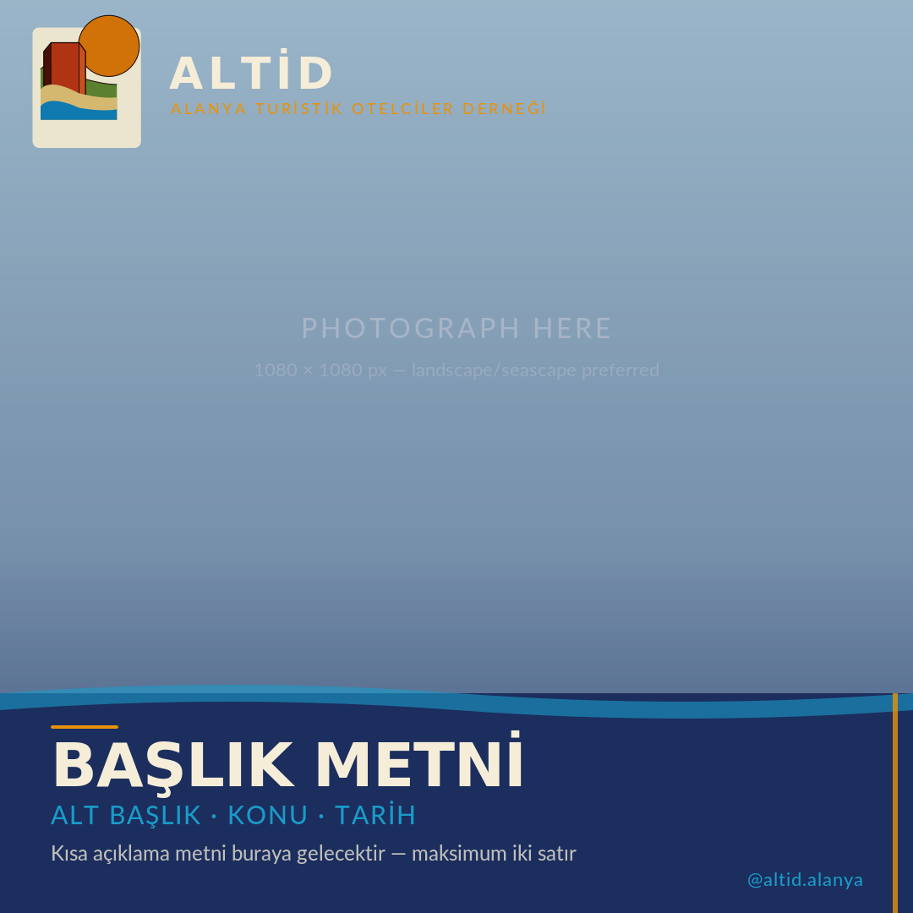
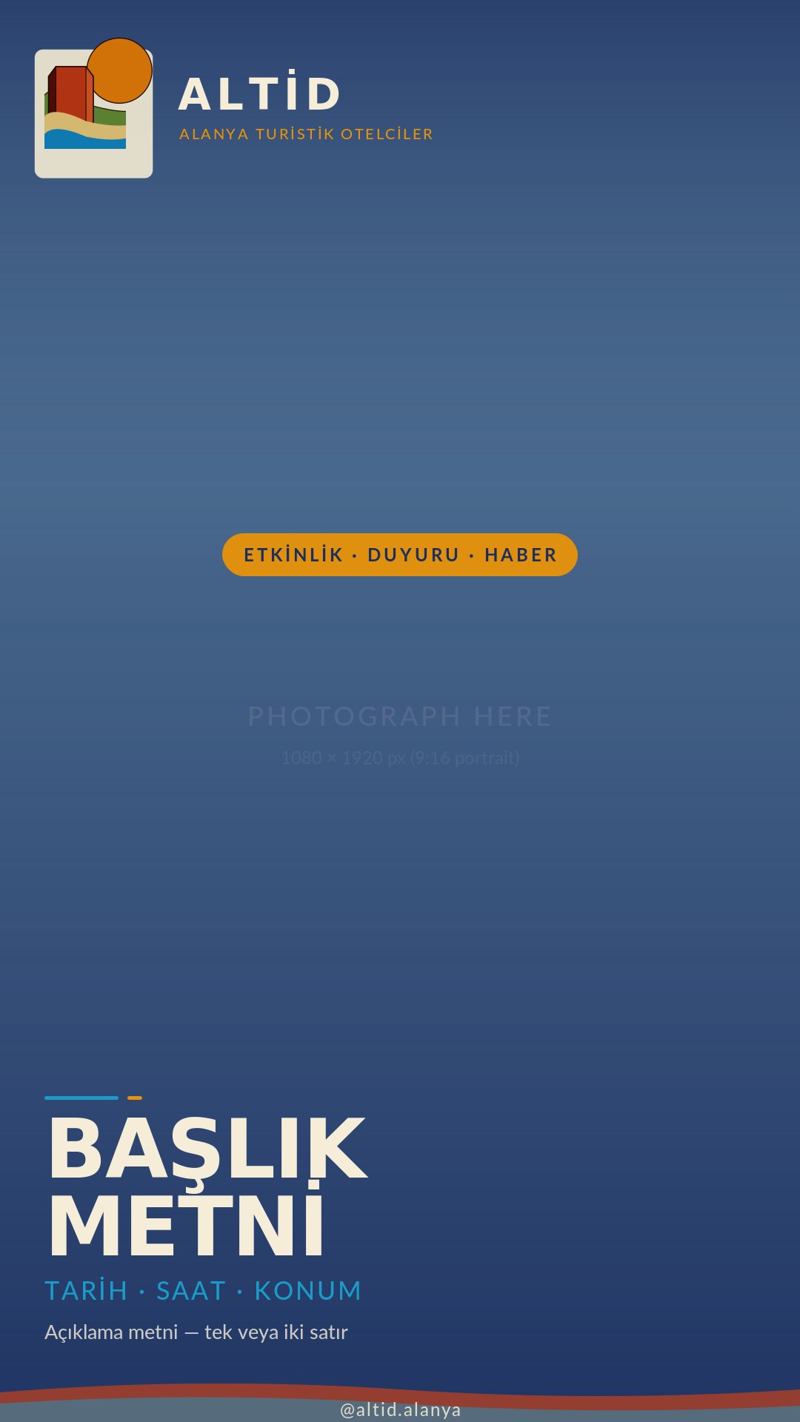
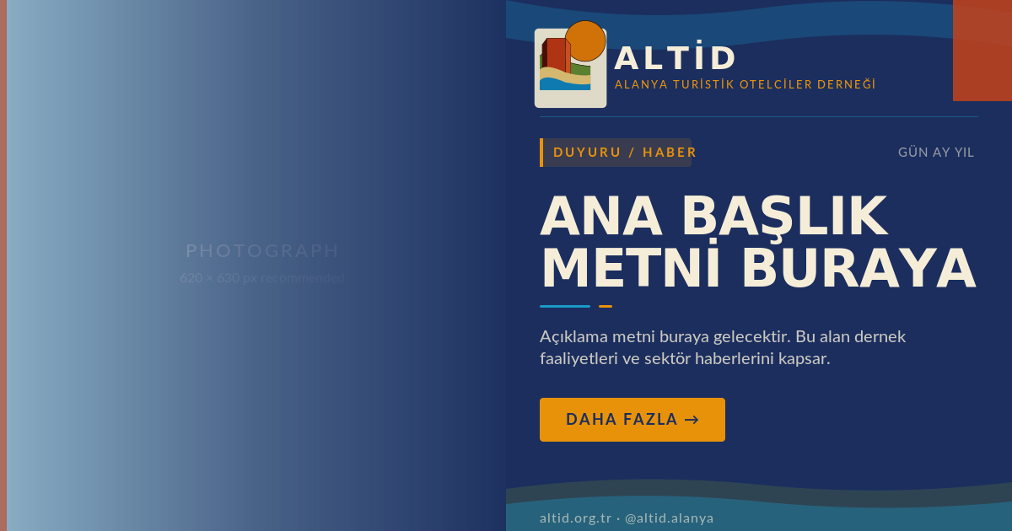
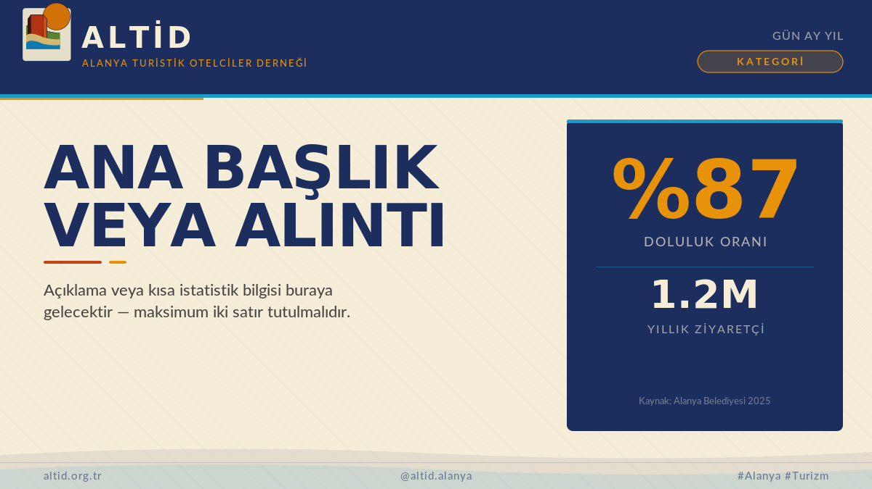
Social Media Post Templates — Overview
Four ready-to-use templates apply the full ALTİD brand system — color palette, logo emblem, Cormorant Garamond / Lato typography — across every major platform format.
Instagram Square
Instagram Story
Facebook / LinkedIn
Twitter / X
1080 × 1080 px · 1:1
1080 × 1920 px · 9:16
1200 × 630 px · 1.91:1
1200 × 675 px · 16:9
Instagram Feed · Facebook Feed
Instagram Stories · Facebook Stories · WhatsApp Status
Facebook Feed · LinkedIn Feed · FB Event Cover
Twitter / X · YouTube Thumbnail
Tourism scenes, event announcements, member spotlights
Time-sensitive updates, event promotions, tourism highlights
Institutional announcements, press releases, sector news
Statistics, quotes, quick updates, sector data
Edit in Figma, Adobe Illustrator, or Inkscape · Export as PNG at native resolution · Source SVG files in posts/ folder

Slide 32
Instagram Square — 1080 × 1080 px
Instagram Feed · Facebook Feed
LAYOUT ZONES
Identity Zone
Logo emblem in cream pill frame + ALTİD wordmark in Cormorant Garamond 700 + gold sub-brand line in Lato 300.
Photo Area
Full-bleed photograph (1080 × 1080 px). Navy gradient overlay deepens from 10% at top to 82% at base for text contrast.
Content Band
Navy panel at base: gold accent rule, Cormorant Garamond headline (72 pt), turquoise sub-headline (Lato 300), body copy (Lato 400).
Handle
@altid.alanya in turquoise bottom-right. Saffron gold accent bar at right edge reinforces brand column identity.
Edit: BAŞLIK METNİ → headline · ALT BAŞLIK · KONU · TARİH → sub-headline · Body copy → two lines max · @altid.alanya → handle

Slide 33
Instagram Story — 1080 × 1920 px
Instagram Stories · Facebook Stories · WhatsApp Status
LAYOUT ZONES
Top Zone
Logo emblem + wordmark on navy. Top-safe area respects 250 px UI margin. Heavy navy gradient overlay protects readability.
Event Badge
Centered gold pill badge in upper-mid area. Use for category label: ETKİLİK / DUYURU / HABER.
Photo Window
Full-bleed portrait photo (1080 × 1920 px). Dual gradient: heavy navy top + heavy navy bottom, clear in centre.
Content Block
Bottom 440 px: turquoise + gold accent rules, large Cormorant headline (2–3 lines), Lato body text, CTA button.
Edit: ETKİNLİK · DUYURU · HABER → badge category · BAŞLIK METNİ → headline (2 lines) · Body text → two lines · DAHA FAZLA → → CTA text

Slide 34
Facebook / LinkedIn — 1200 × 630 px
Facebook Feed · LinkedIn Feed · Facebook Event Cover
LAYOUT ZONES
Photo Half
Left 620 px: full-height photograph with horizontal fade gradient (clear at left → navy at right), blending into content panel.
Navy Panel
Right 600 px: Mediterranean Navy background. Turquoise wave accent top edge. Terracotta corner block top-right.
Logo + Wordmark
Logo emblem (62% scale) + ALTİD wordmark in Cormorant Garamond, Lato sub-brand line in gold. Turquoise divider rule below.
Content Area
Gold category tag with left accent bar. Date top-right. Cormorant Garamond headline (62 pt, two lines). Body text + handle.
Edit: DUYURU / HABER → category label · GÜN AY YIL → date · ANA BAŞLIK METNİ BURAYA → headline · Body text → 3 lines max · @altid.alanya → handle

Slide 35
Twitter / X — 1200 × 675 px
Twitter / X · YouTube Thumbnail
LAYOUT ZONES
Navy Header
Full-width navy bar (130 px). Logo emblem at left. ALTİD wordmark + gold sub-brand. Date and category pill tag at right.
Aegean Sand BG
Warm sand background (#F5EDD8) with subtle diagonal turquoise line texture. Turquoise + gold accent lines below header.
Left Column
Large Cormorant Garamond headline (82 pt, navy on sand). Turquoise + gold paired accent rule. Body text in Lato 300.
Right Accent
Navy accent panel right side. Statistics or pull-quote in large display type. Turquoise wave strip and handle at bottom.
Edit: KATEGORİ → category tag · GÜN AY YIL → date · ANA BAŞLIK → headline · STAT / QUOTE area → large number or pull-quote · @altid.alanya → handle

Slide 36
07 Flag Design Examples
Brand identity applied to institutional and event flags

Slide 37
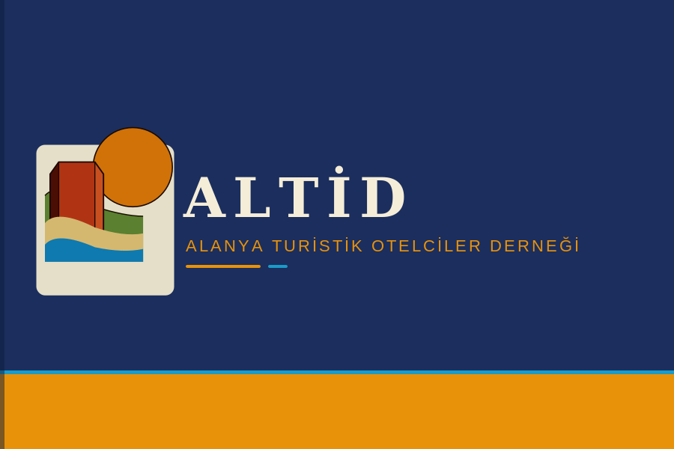
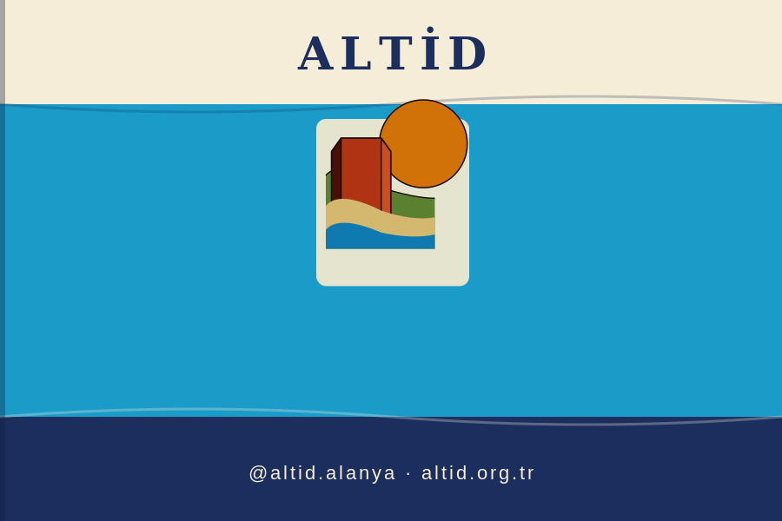
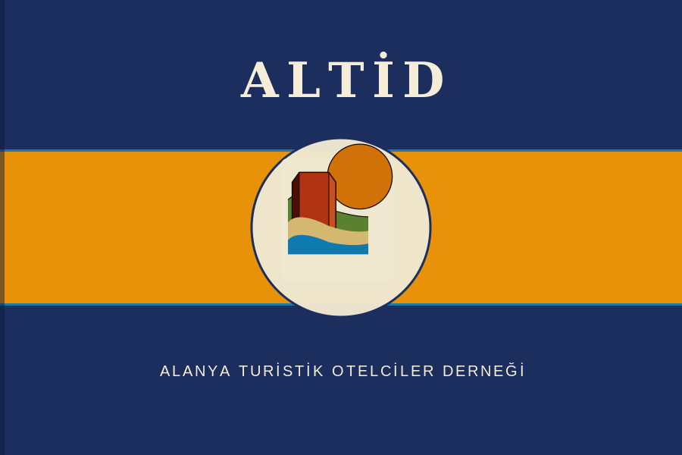
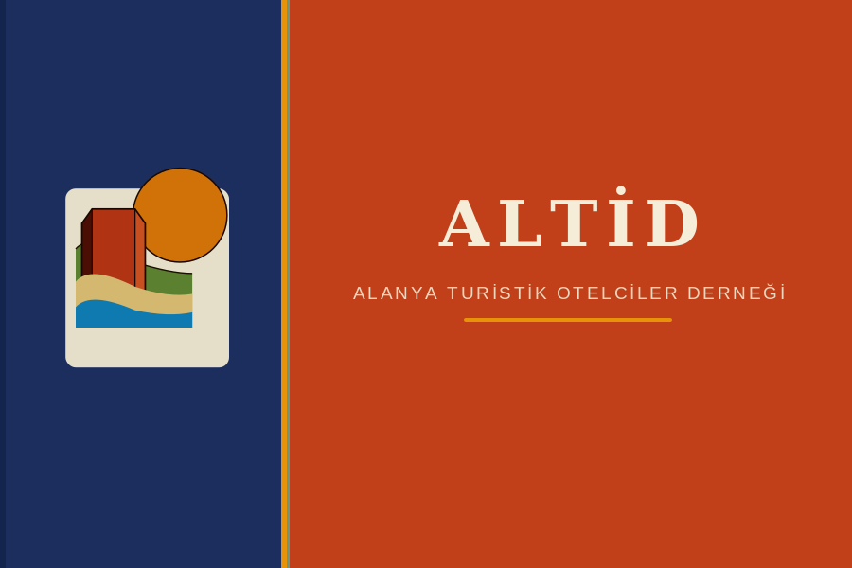
Flag Design Examples — Overview
Four flag concepts apply the ALTİD brand system to physical identity contexts. Each variant is optimised for a specific setting — from formal governmental liaison to beachside hospitality venues.
A — Institutional
B — Tourism
Navy field · Gold base stripe
Turquoise field · Cream & Navy bands
All flags use standard 3:2 proportions (900 × 600 px) · SVG source files available for print and fabrication
C — Ceremonial
D — Heritage
Navy–Gold–Navy triband · Badge centre
Terracotta field · Navy hoist panel

Slide 38
Flag A — Institutional / Official
Government offices · Municipal liaison · Headquarters entrance · Formal correspondence backgrounds
DESIGN RATIONALE
Mediterranean Navy dominates the field — the primary brand colour communicating authority and institutional trust. The Saffron Gold base stripe (1/6 height) echoes the sun and warmth motif without compromising the formal register. A Turquoise rule separates the two zones. The logo emblem sits left-of-field in a cream pill frame, paired with the full wordmark in Cormorant Garamond.
SPECIFICATIONS
Field
Mediterranean Navy #1B2E5E
Base stripe
Saffron Gold #E8920A (1/6 height)
Accent rule
Mediterranean Turquoise #1A9BC8
Wordmark
Cormorant Garamond 700 · Aegean Sand
Sub-brand
Lato 300 · Saffron Gold
Proportions
3:2 (900 × 600 px)
Context: Government offices · Municipal liaison · Headquarters entrance · Formal correspondence backgrounds

Slide 39
Flag B — Tourism / Hospitality
Hotel entrances · Beach venues · Tourism fairs · Marina berths · Resort signage
DESIGN RATIONALE
Mediterranean Turquoise takes the field — the colour most viscerally associated with Alanya's coastal waters. An Aegean Sand header band carries the wordmark in Navy, evoking beach and sky. The Navy base stripe grounds the design and anchors the ALTİD handle. Subtle wave-curve dividers reference the logo's landscape bands. The logo emblem is centred prominently on the turquoise field.
SPECIFICATIONS
Field
Mediterranean Turquoise #1A9BC8
Header band
Aegean Sand #F5EDD8 (1/5 height)
Base stripe
Mediterranean Navy #1B2E5E (1/5 height)
Wave dividers
Navy / Sand 25–30% opacity
Wordmark
Cormorant Garamond 700 · Mediterranean Navy
Proportions
3:2 (900 × 600 px)
Context: Hotel entrances · Beach venues · Tourism fairs · Marina berths · Resort signage

Slide 40
Flag C — Ceremonial / Events
Galas · Award ceremonies · Annual congresses · Trade fair stands · Stage dressing
DESIGN RATIONALE
A triband of Navy–Gold–Navy creates maximum visual impact at distance. The proportions are equal thirds, giving the gold centre band strong presence. The logo emblem is set inside a cream circle on the gold band — a medallion motif that reads well both close-up and at height. ALTİD wordmark occupies the top navy band in large display size; the full organisation name anchors the bottom band in Lato light.
SPECIFICATIONS
Top / Bottom
Mediterranean Navy #1B2E5E (1/3 each)
Centre band
Saffron Gold #E8920A (1/3 height)
Band dividers
Mediterranean Turquoise #1A9BC8 (3 px)
Badge
Cream circle #F0E8D0 r=118 px
Wordmark
Cormorant Garamond 700 · Aegean Sand 64 pt
Proportions
3:2 (900 × 600 px)
Context: Galas · Award ceremonies · Annual congresses · Trade fair stands · Stage dressing

Slide 41
Flag D — Heritage / Kızılkule
Cultural heritage events · Kızılkule (Red Tower) site · Castle festivals · Archaeological contexts
DESIGN RATIONALE
Alanya Terracotta references the literal colour of the Red Tower (Kızılkule, 1226 CE) and the castle walls. A Navy hoist panel (1/3 width) carries the logo emblem — creating a canton-style layout familiar from traditional flags. The Saffron Gold vertical divider with a Turquoise inner line separates the two zones with brand precision. The full wordmark is centred on the terracotta fly field in sand-cream.
SPECIFICATIONS
Fly field
Alanya Terracotta #C4421A
Hoist panel
Mediterranean Navy #1B2E5E (1/3 width)
Divider
Saffron Gold #E8920A (9 px) + Turquoise (3 px)
Wordmark
Cormorant Garamond 700 · Aegean Sand 68 pt
Sub-brand
Lato 300 · Aegean Sand 19 pt
Proportions
3:2 (900 × 600 px)
Context: Cultural heritage events · Kızılkule (Red Tower) site · Castle festivals · Archaeological contexts

